Slide 1
NOTION
https://www.notion.so/
The practical guide

Slide 2
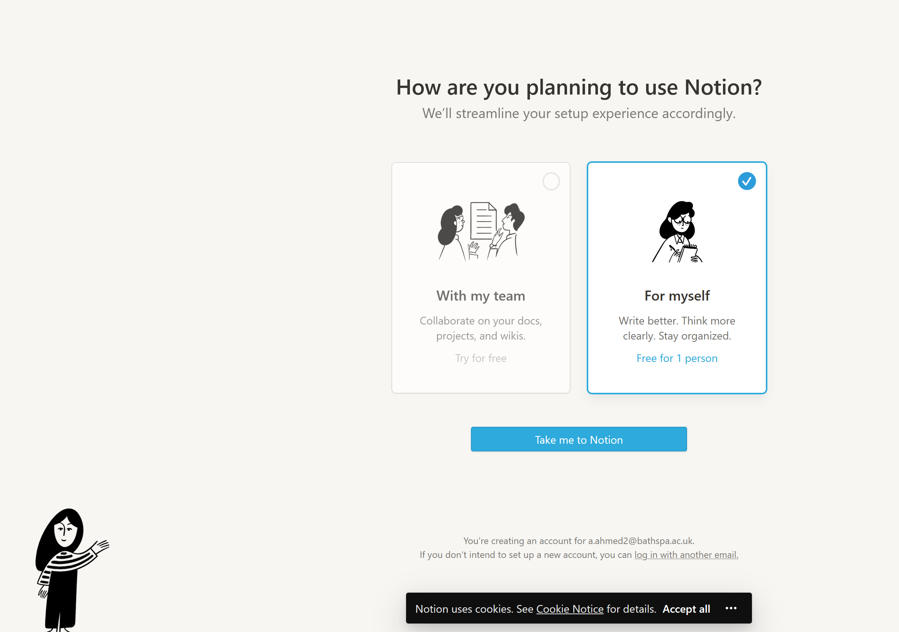
After Sign Up

Slide 3
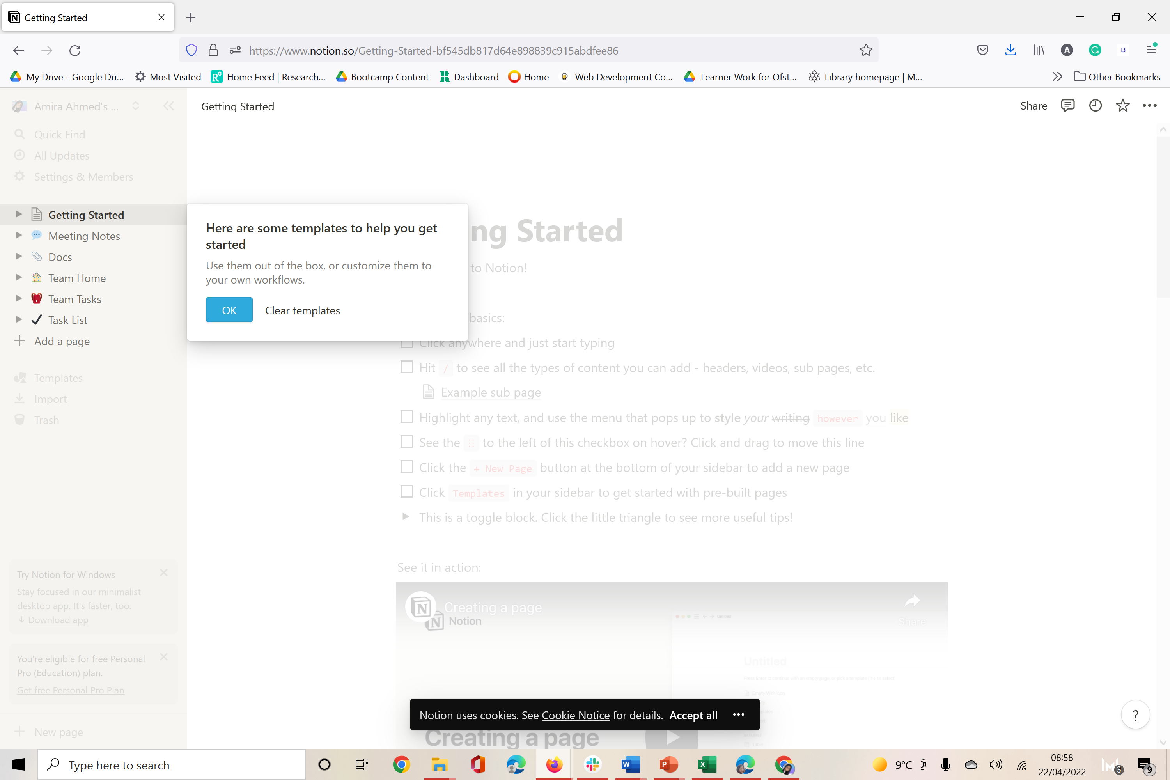
Explore Different Templates

Slide 4
Follow Youtube channel for more info
https://www.youtube.com/c/notion

